Slide 1

Auto Insurance Portfolio & Risk Analysis
Data-Driven Insights for Risk Optimization and Customer Segmentation
Presenter: Ebube | Data Analytics Project

Slide 2
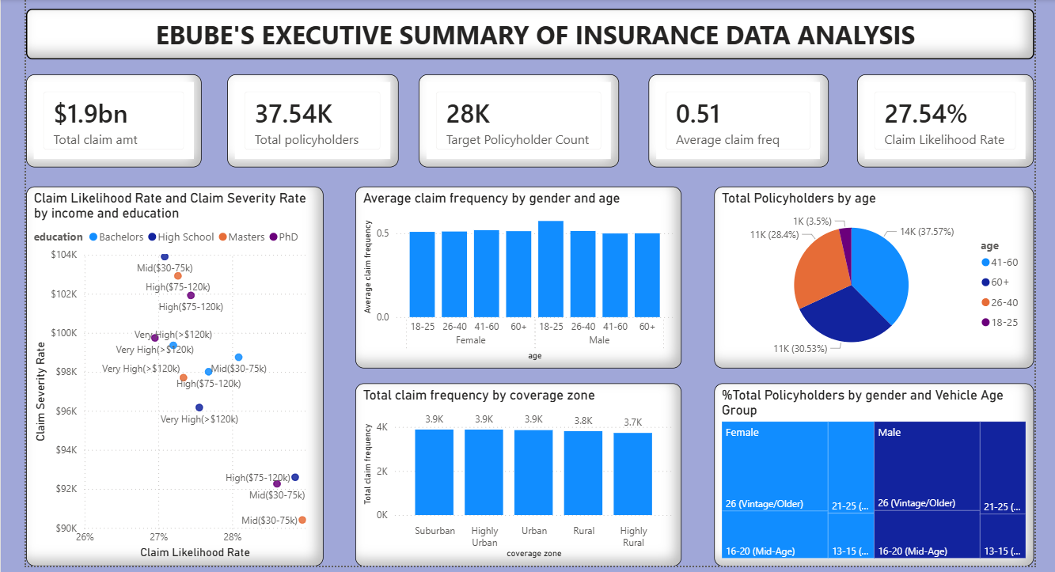
Executive Overview: High-Level Portfolio Performance
$1.90B Total Claims Paid across 37.54K active policyholders.
Average claim frequency sits at 0.51, with an overall portfolio Claim Likelihood Rate of 27.54%.
Average severity per claim event stands at $98.04K.
75.21% (28K) of policyholders fall into our high-value target segment

Slide 3
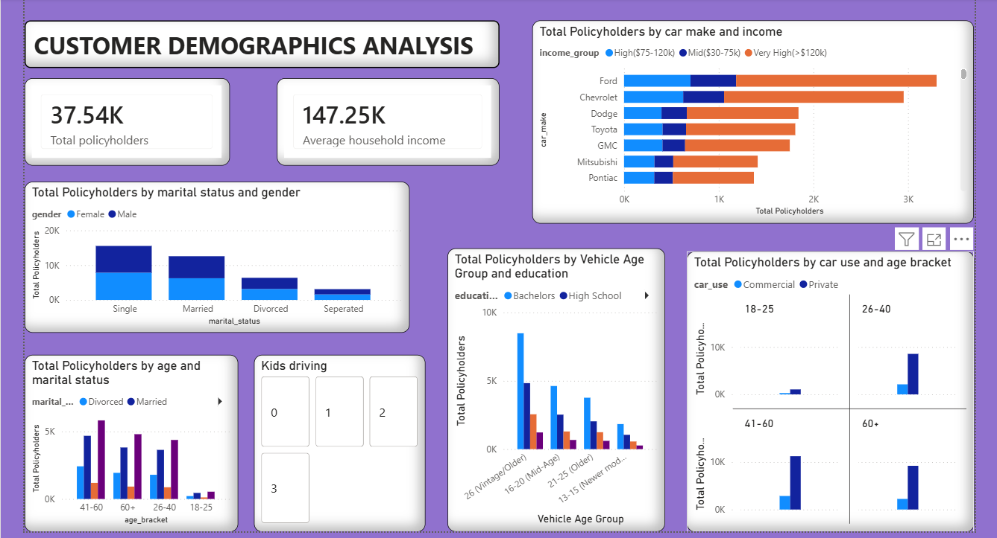
Customer Profile: Mature, Private-Vehicle Heavy Base
Age Core: Policyholders aged 41–60 (37.57%) and 60+ (30.53%) comprise over 68% of the customer base.
Marital & Gender: Single (16K) and Married (12K) form the largest segments with a balanced 50/50 gender split.
Usage: Over 80% of vehicles are registered for Private rather than Commercial use.

Slide 4
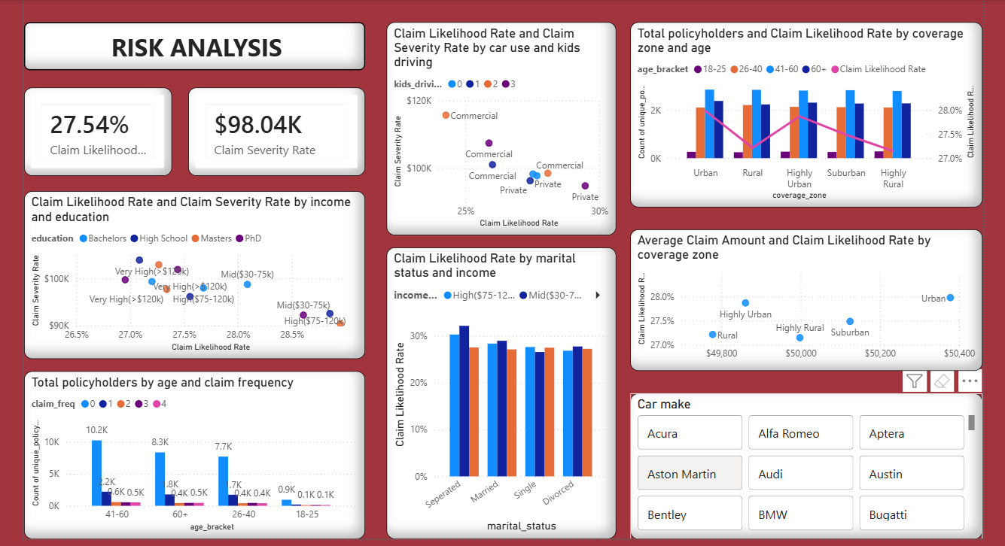
Risk Assessment: Pinpointing High Severity Exposure
Income & Education: High School educated policyholders in the $30k–$75k income bracket present the highest risk (28.2% likelihood, $104K severity).
Geographic Impact: Urban & Highly Urban zones show higher claim probability (28.0%) vs. Rural (27.0%).
Critical Risk Factor: Commercial vehicles driven by children experience severe claim spikes exceeding $110K per claim event.

Slide 5
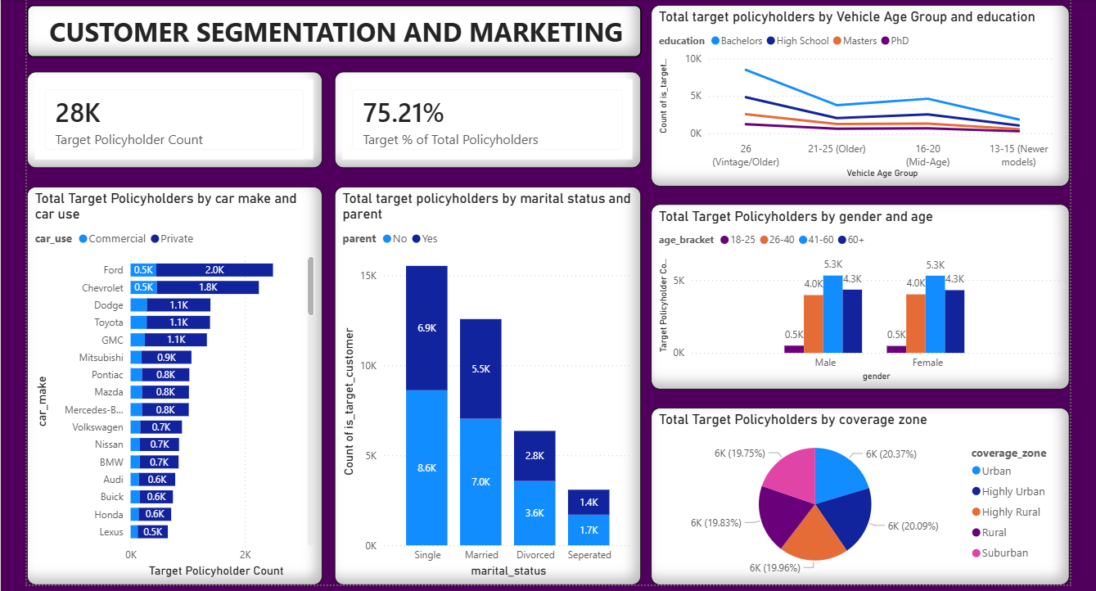
Customer Target Segment: The 28K High Value Foundation
Segment Definition: Household Income > $75K with ≤ 1 claim (28K policyholders).
Profile: Concentrated in ages 41–60+ (10.6K) holding Bachelor's degrees and driving vehicles aged 16+ years.
Geographic Spread: Evenly distributed across all 5 coverage zones (~20% each), enabling broad regional marketing campaigns.

Slide 6
Action Plan: Optimizing Portfolio Profitability
Pricing Policy: Apply a surcharge to Commercial policies with youth drivers to mitigate high claim severity.
Regional Rating: Adjust Urban base premiums upward by 2–3% to align with higher local claim likelihood.
Marketing Action: Direct retention budgets toward single/married high-income drivers operating private vehicles.

